Slide 1
ANDROID Sensors

Slide 2
Overview
Most Android-powered devices have built-in sensors that measure motion, orientation, and various environmental conditions.
These sensors are capable of providing raw data with high precision and accuracy, and are useful if you want to monitor three-dimensional device movement or positioning, or you want to monitor changes in the ambient environment near a device.
For example, a game might track readings from a device's gravity sensor to infer complex user gestures and motions, such as tilt, shake, rotation, or swing.
Likewise, a weather application might use a device's temperature sensor and humidity sensor to calculate and report the dew point.
Or a travel application might use the geomagnetic field sensor and accelerometer to report a compass bearing.

Slide 3
Types of Sensors
Mainly of 3 types
Motion sensors:
These sensors measure acceleration forces and rotational forces along three axes. This category includes accelerometers, gravity sensors, gyroscopes, and rotational vector sensors.
Environmental sensors:
These sensors measure various environmental parameters, such as ambient air temperature and pressure, illumination, and humidity. This category includes barometers, photometers, and thermometers.
Position sensors:
These sensors measure the physical position of a device. This category includes orientation sensors and magnetometers.

Slide 4
Android Sensor Framework
You can access sensors available on the device and acquire raw sensor data by using the Android sensor framework.
The sensor framework provides several classes and interfaces that help you perform a wide variety of sensor-related tasks. For example, you can use the sensor framework to do the following:
Determine which sensors are available on a device.
Determine an individual sensor's capabilities, such as its maximum range, manufacturer, power requirements, and resolution.
Acquire raw sensor data and define the minimum rate at which you acquire sensor data.
Register and unregister sensor event listeners that monitor sensor changes.

Slide 5
Sensor Hardware/Software
The Android sensor framework lets you access many types of sensors.
They are either hardware based or software based.
Hardware Based:
They are physical components built into a handset or tablet device.
They derive their data by directly measuring specific environmental properties, such as acceleration, geomagnetic field strength, or angular change.
Software Based:
These sensors are not physical devices, although they mimic hardware-based sensors.
Software-based sensors derive their data from one or more of the hardware-based sensors and are sometimes called virtual sensors or synthetic sensors.
The linear acceleration sensor and the gravity sensor are examples of software-based sensors.
Few Android-powered devices have every type of sensor.
Also, a device can have more than one sensor of a given type. For example, a device can have two gravity sensors, each one having a different range.

Slide 6
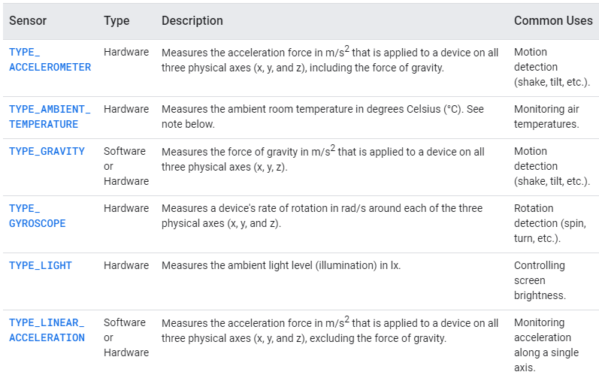
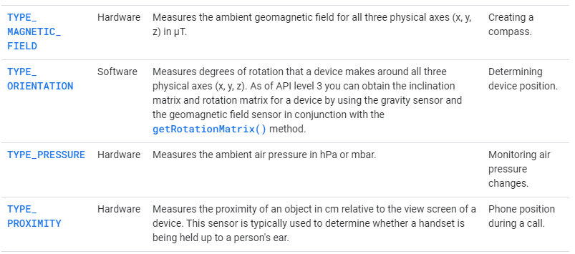
Sensor Types supported by Android Platform
Visit: Full Chart of Sensor types

Slide 7
Sensor Framework Classes
SensorManager
You can use this class to create an instance of the sensor service. This class provides various methods for: Accessing and listing sensors, registering and unregistering sensor event listeners and acquiring orientation information.
This class also provides several sensor constants that are used to report sensor accuracy, set data acquisition rates, and calibrate sensors.
Sensor
You can use this class to create an instance of a specific sensor. This class provides various methods that let you determine a sensor's capabilities.
SensorEvent
The system uses this class to create a sensor event object, which provides information about a sensor event.
A sensor event object includes the following information:
The raw sensor data,
The type of sensor that generated the event,
The accuracy of the data, and the
Timestamp for the event.
SensorEventListener
You can use this interface to create two callback methods that receive notifications (sensor events) when sensor values change or when sensor accuracy changes.

Slide 8

Identifying Sensors: SensorManager
The Android sensor framework provides several methods that make it easy for you to determine at runtime which sensors are on a device.
To identify the sensors that are on a device you first need to get a reference to the sensor service. To do this, you create an instance of the SensorManager class by calling the getSystemService() method and passing in the SENSOR_SERVICE argument.
Next, you can get a listing of every sensor on a device by calling the getSensorList() method and using the TYPE_ALL constant.
If you want to list all of the sensors of a given type, you could use another constant instead of TYPE_ALL such as TYPE_GYROSCOPE, TYPE_LINEAR_ACCELERATION, or TYPE_GRAVITY.

Slide 9
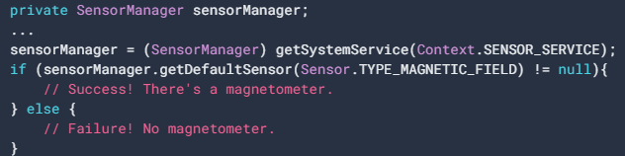
Identifying Sensors: SensorManager
You can also determine whether a specific type of sensor exists on a device by using the getDefaultSensor() method and passing in the type constant for a specific sensor.
If a device has more than one sensor of a given type, one of the sensors must be designated as the default sensor.
If a default sensor does not exist for a given type of sensor, the method call returns null, which means the device does not have that type of sensor. For example, the following code checks whether there's a magnetometer on a device:

Slide 10
Sensor Capabilities: Sensor Class
Various methods in Sensor class to get capabilities of Sensor
getMinDelay(): Method, which returns the minimum time interval (in microseconds) a sensor can use to sense data.
Any sensor that returns a non-zero value for the getMinDelay() method is a streaming sensor. Streaming sensors sense data at regular intervals and were introduced in Android 2.3 (API Level 9). If a sensor returns zero when you call the getMinDelay() method, it means the sensor is not a streaming sensor because it reports data only when there is a change in the parameters it is sensing.
getPower(): Method to obtain a sensor's power requirements. (in mA microAmps)
getMaximumRange(): Method to obtain maximum range of measurement.
getResolution(): Method to obtain a sensor's resolution.

Slide 11
Monitoring Sensor Events
To monitor raw sensor data you need to implement two callback methods that are exposed through the SensorEventListener interface: onAccuracyChanged() and onSensorChanged().
A sensor's accuracy changes:
In this case the system invokes the onAccuracyChanged() method, providing you with a reference to the Sensor object that changed and the new accuracy of the sensor.
Accuracy is represented by one of four status constants: SENSOR_STATUS_ACCURACY_LOW, SENSOR_STATUS_ACCURACY_MEDIUM, SENSOR_STATUS_ACCURACY_HIGH, or SENSOR_STATUS_UNRELIABLE.
A sensor reports a new value:
In this case the system invokes the onSensorChanged() method, providing you with a SensorEvent object.
A SensorEvent object contains information about the new sensor data, including: the accuracy of the data, the sensor that generated the data, the timestamp at which the data was generated, and the new data that the sensor recorded.

Slide 12
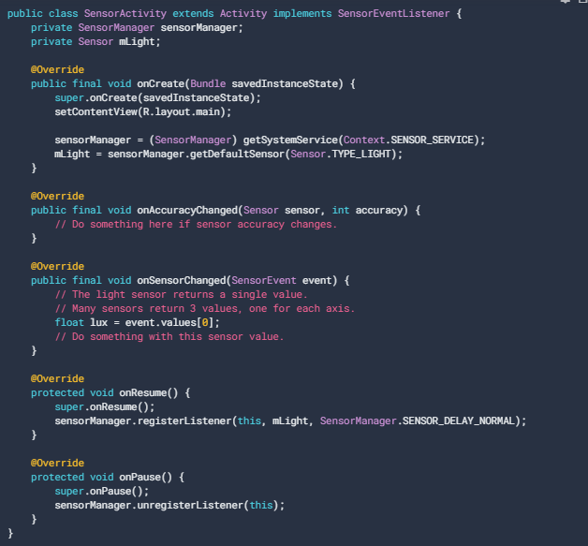
Sensor Events (Example Code)

Slide 13
Code Explained
The parameters in registering a Event Listener:
registerListener( SensorEventListener, Sensor, int data_delay). This data_delay can be: • SENSOR_DELAY_NORMAL • SENSOR_DELAY_UI • SENSOR_DELAY_GAME • SENSOR_DELAY_FASTEST • time in microseconds (millionths of a second)
The data delay (or sampling rate) controls the interval at which sensor events are sent to your application via the onSensorChanged() callback method.
The default data delay is suitable for monitoring typical screen orientation changes and uses a delay of 200,000 microseconds.
You can specify other data delays, such as SENSOR_DELAY_GAME (20,000 microsecond delay), SENSOR_DELAY_UI (60,000 microsecond delay), or SENSOR_DELAY_FASTEST (0 microsecond delay). As of Android 3.0 (API Level 11) you can also specify the delay as an absolute value (in microseconds).
Question: Which Delay should you select?

Slide 14
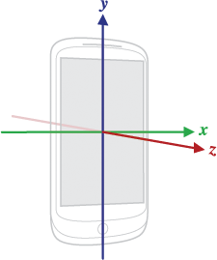
Sensor Coordinate System
In general, the sensor framework uses a standard 3-axis coordinate system to express data values.
For most sensors, the coordinate system is defined relative to the device's screen when the device is held in its default orientation (see figure).
When a device is held in its default orientation, the X axis is horizontal and points to the right, the Y axis is vertical and points up, and the Z axis points toward the outside of the screen face.
In this system, coordinates behind the screen have negative Z values. This coordinate system is used by the following sensors:
Acceleration sensor
Gravity sensor
Gyroscope
Linear acceleration sensor
Geomagnetic field sensor
Figure: Coordinate system (relative to a device) that's used by the Sensor API.

Slide 15
Best Practices for Using Sensors
Only gather sensor data in the foreground
Unregister sensor listeners
Test with the Android Emulator
Don't block the onSensorChanged() method
Avoid using deprecated methods or sensor types
Verify sensors before you use them
Choose sensor delays carefully

Slide 16
THANK YOU

